Slide 1
Resolution in
First Order Logic
Fundamentals of Artificial Intelligence
Slides are mostly adapted from AIMA and MIT Open Courseware
and Milos Hauskrecht (U. Pittsburgh)

Slide 2
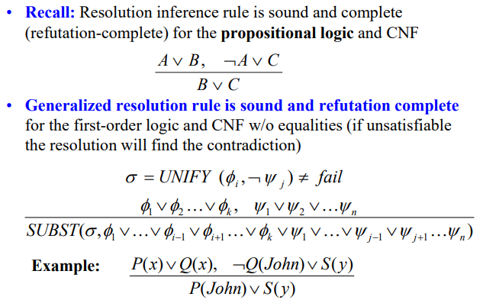
Resolution Inference Rule

Slide 3
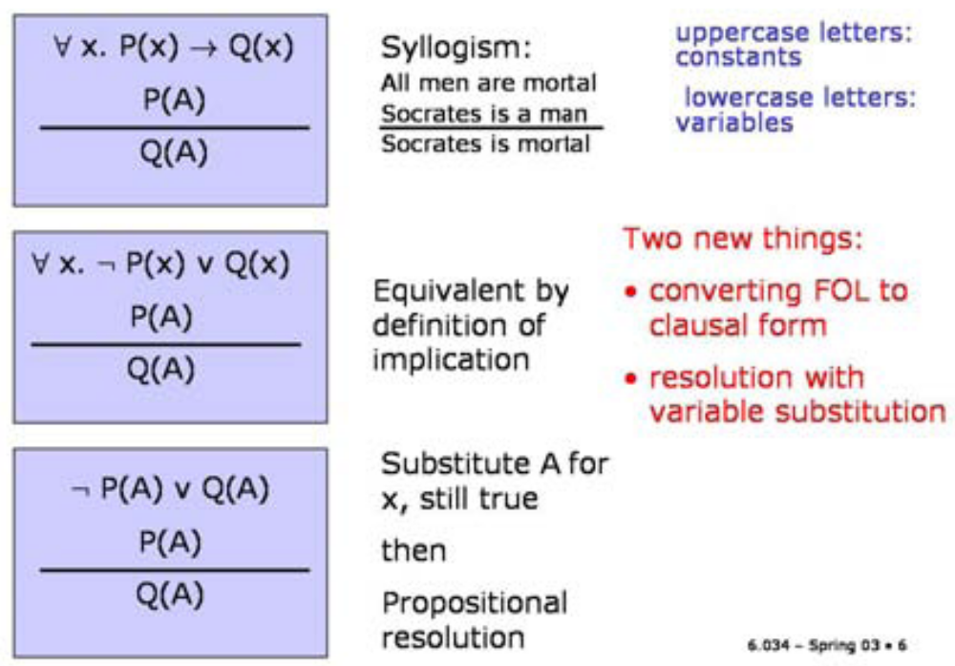
First Order Resolution

Slide 4
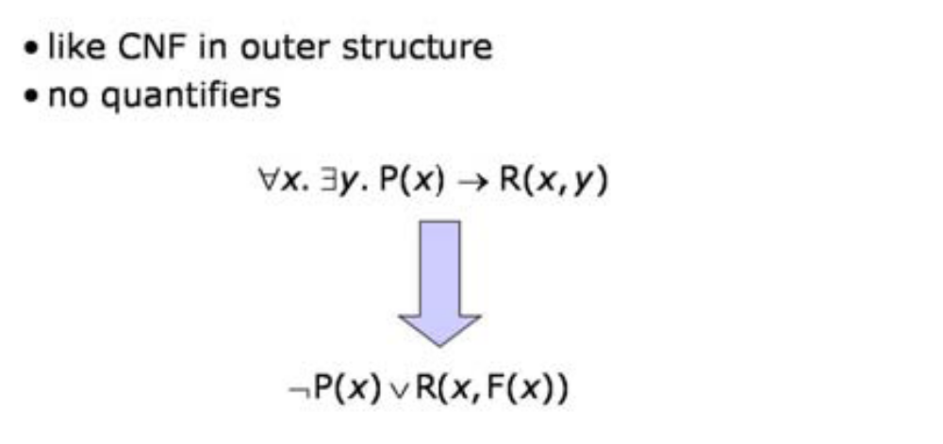
Clausal Form

Slide 5
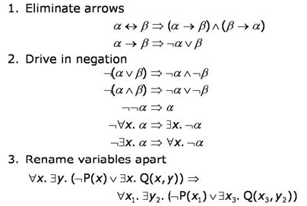
Converting to Clausal Form
Also move all quantifiers left

Slide 6
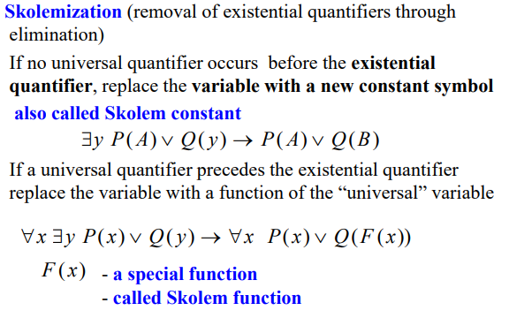
Converting to Clausal Form - Skolemization

Slide 7
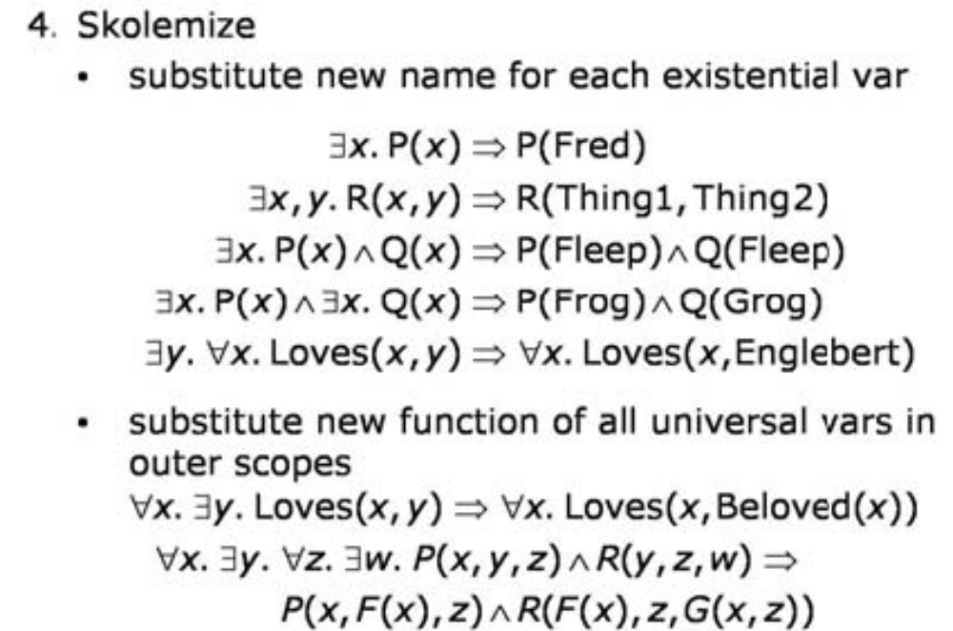
Converting to Clausal Form - Skolemization

Slide 8
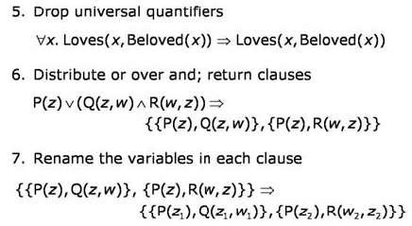
Converting to Clausal Form

Slide 9
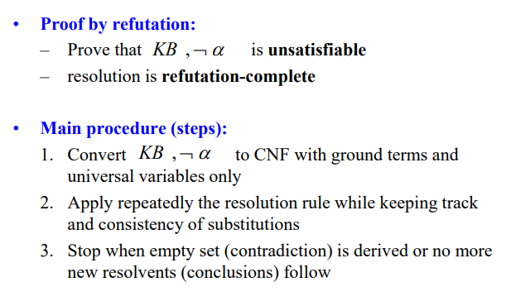

Inference with resolution rule

Slide 10
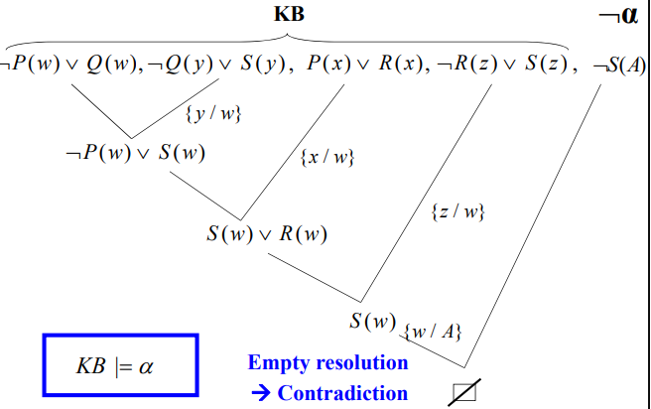

Slide 11
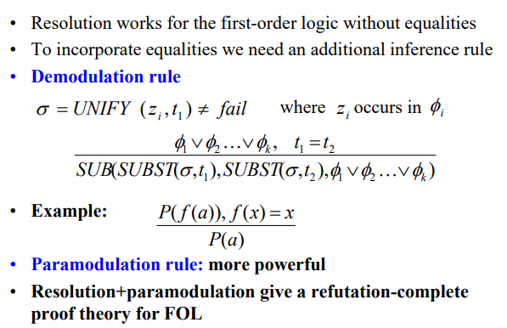
Dealing with Equality

Slide 12
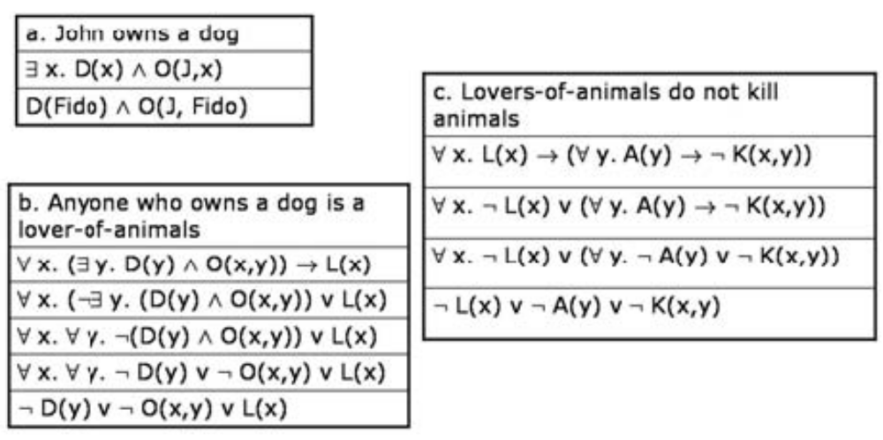
Example

Slide 13
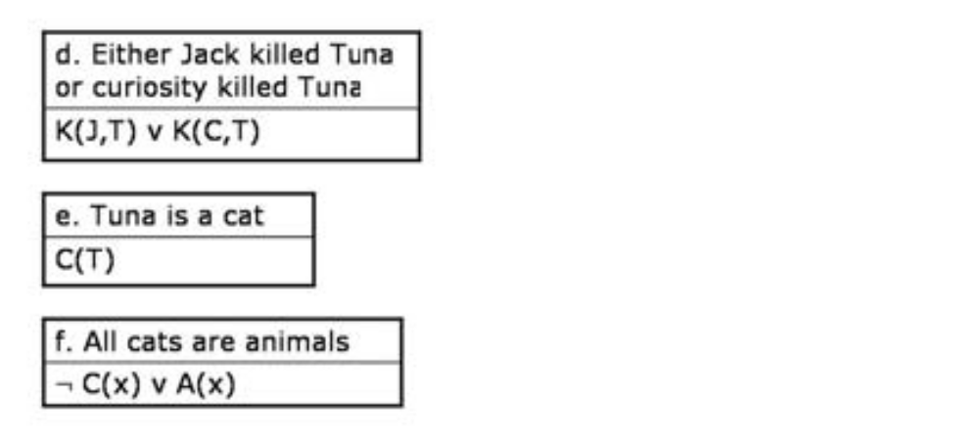
More examples

Slide 14
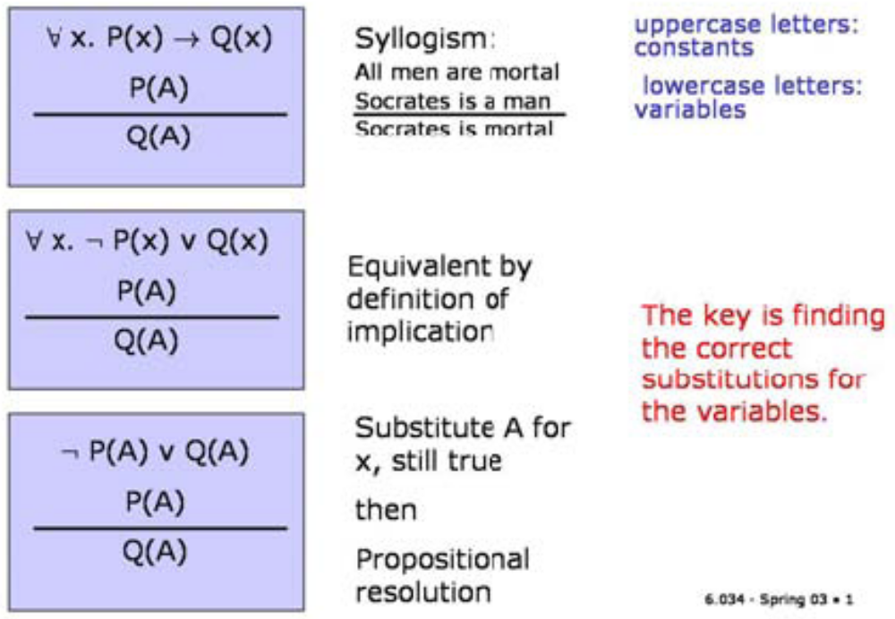
First Order Resolution

Slide 15
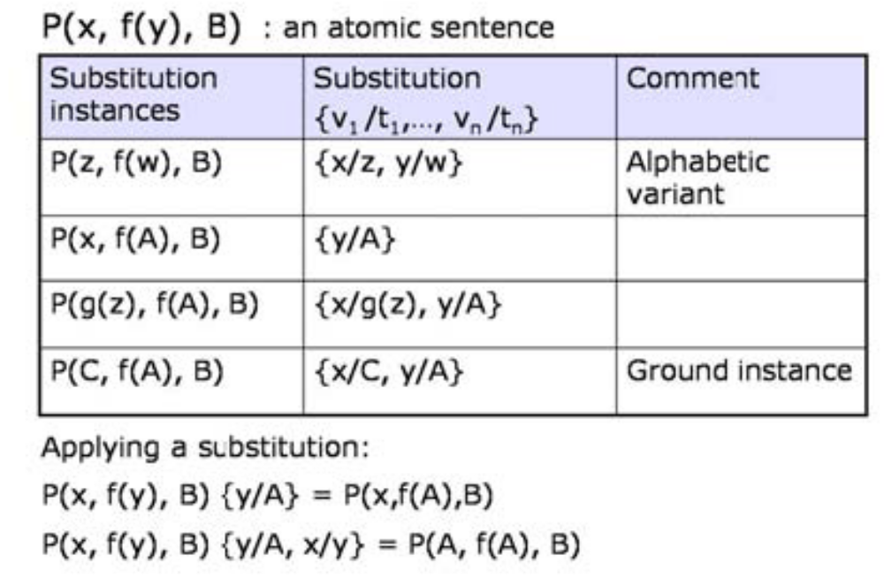
Substitutions

Slide 16
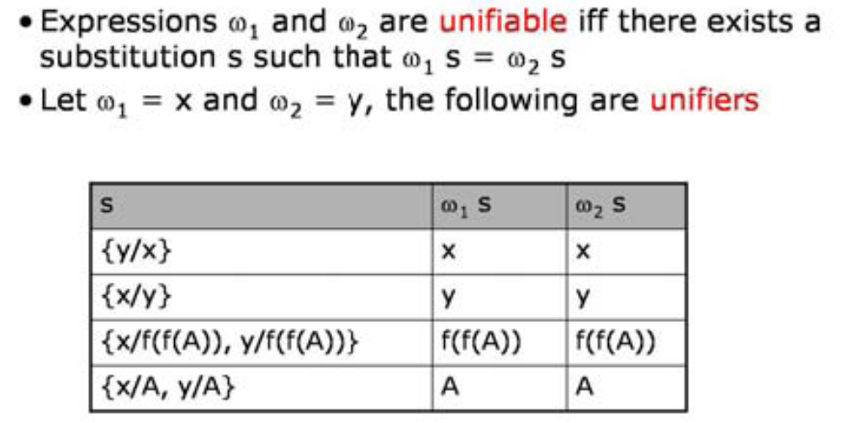
Unification

Slide 17
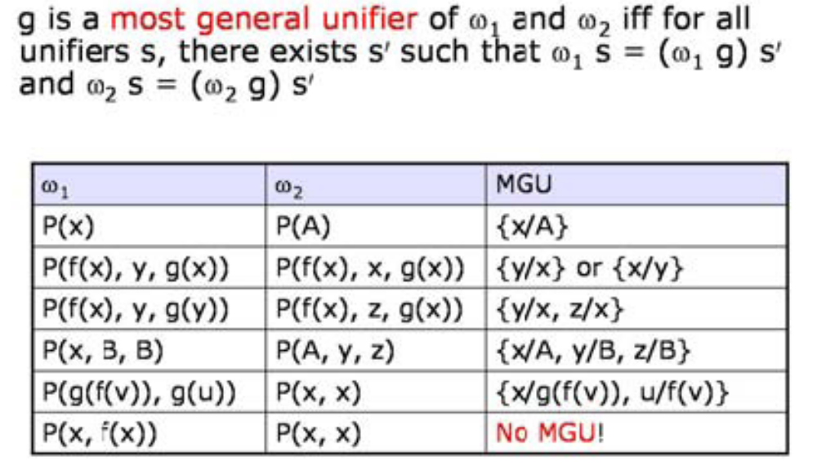
Most General Unifier

Slide 18
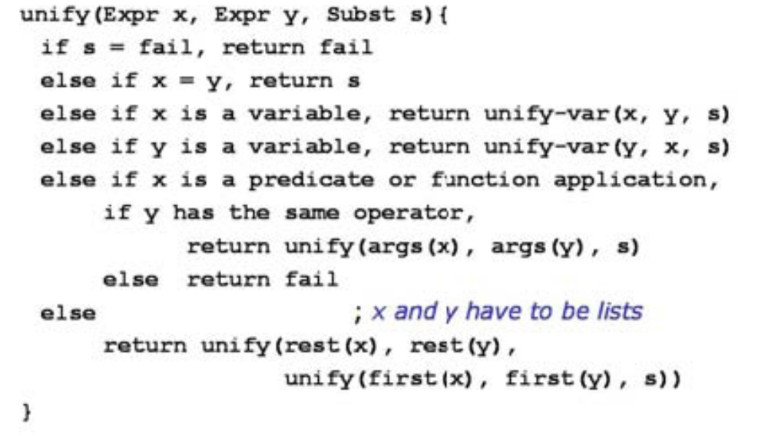
Unification Algorithm

Slide 19
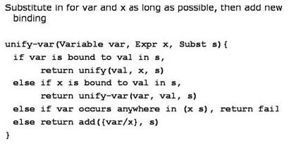
Unify-var subroutine

Slide 20
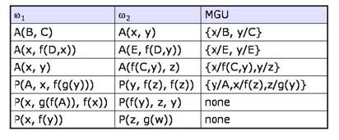
Examples

Slide 21
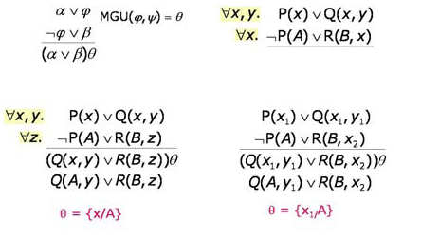
Resolution with Variables

Slide 22
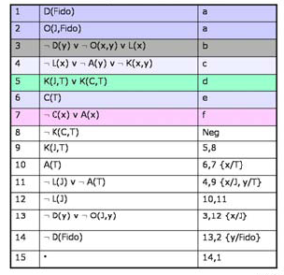
Curiosity Killed the Cat

Slide 23
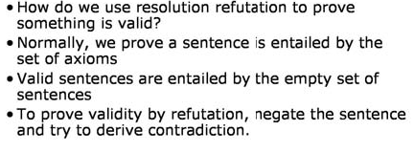
Proving Validity

Slide 24
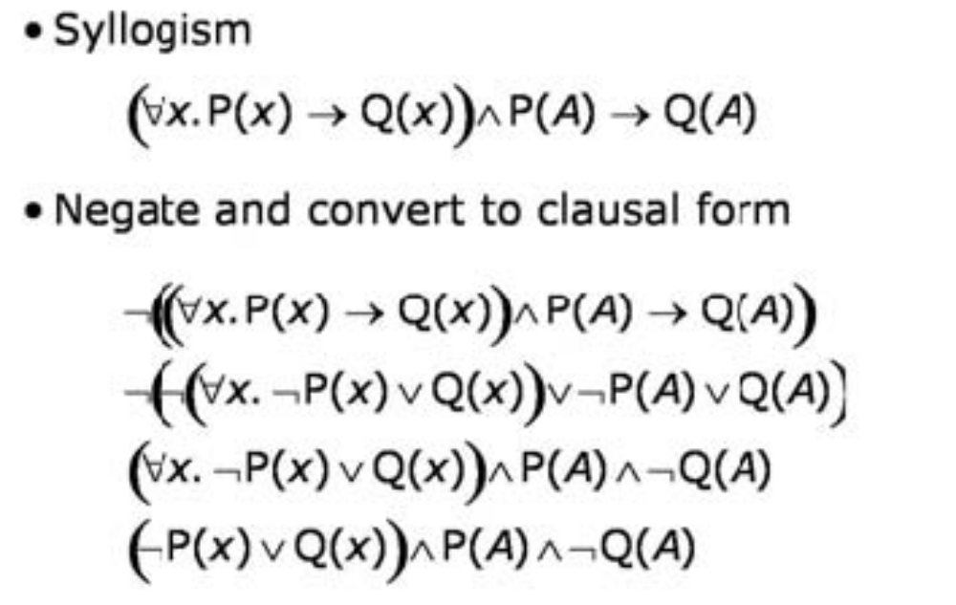
Example

Slide 25
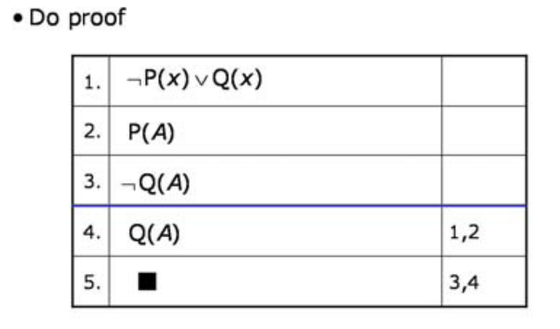
Example

Slide 26
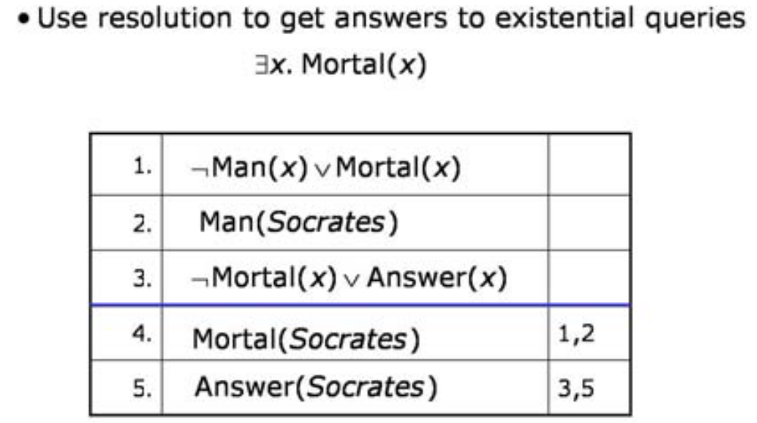
Green’s Trick

Slide 27
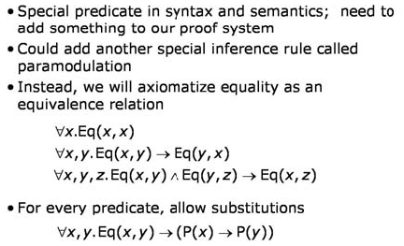
Equality

Slide 28
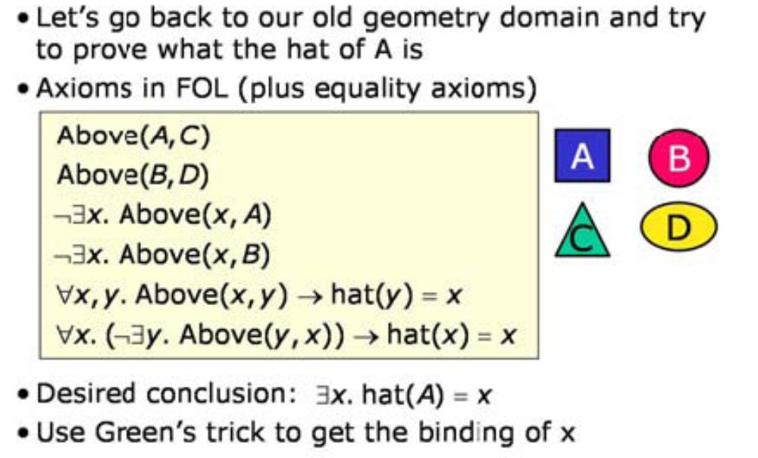
Proof Example

Slide 29
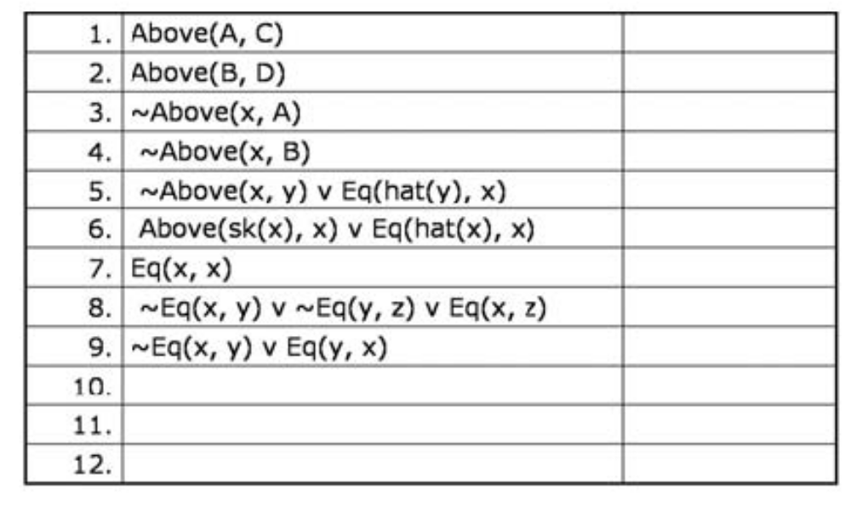
The Clauses

Slide 30
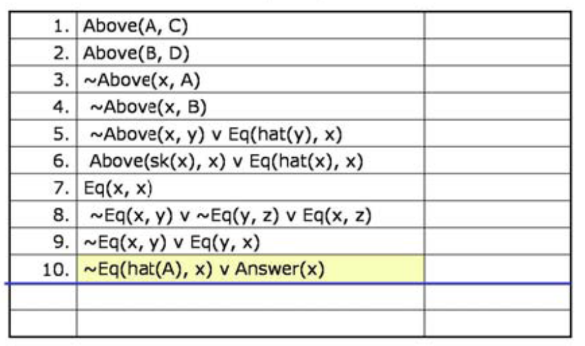
The Query

Slide 31
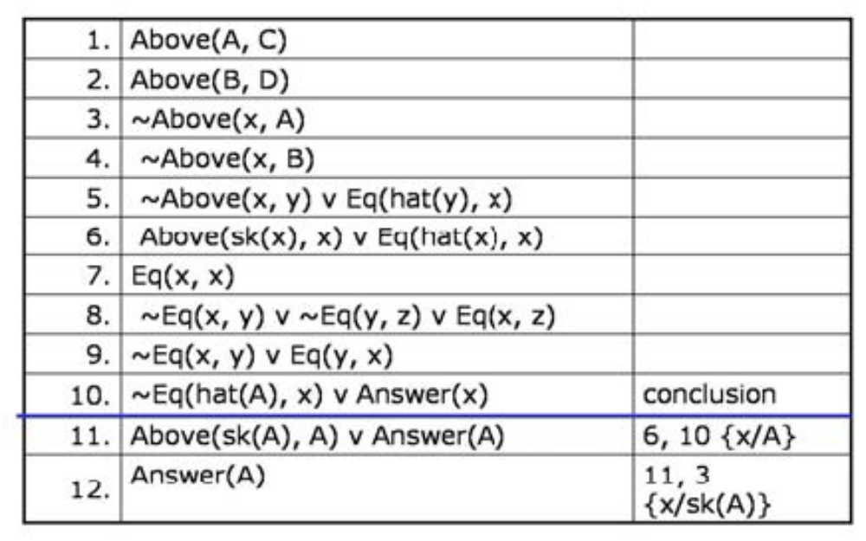
The Proof

Slide 32
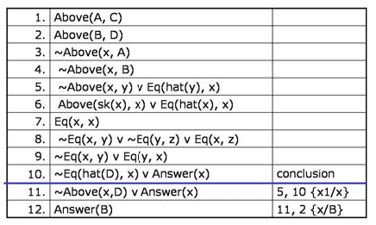
Hat of D

Slide 33
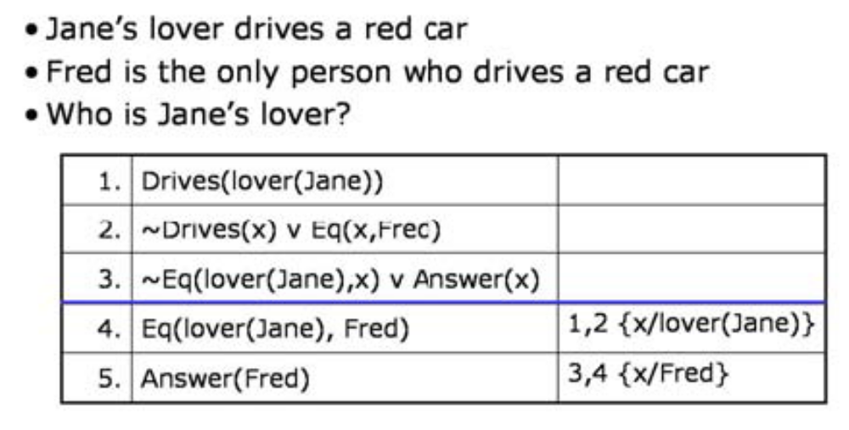
Who is Jane’s Lower

